Slide 1
Science
Unit 1 Plants and humans as organism
Unit 2 Cells and organisms
Unit 3 Living things in their environment
Unit 4 Variation and classification
Biology
Unit 5 States of matter
Unit 6 Material properties
Unit 7 Material changes
Unit 8 The earth
Chemistry
Unit 9 Forces and motion
Unit10 Energy
Unit11 The earth and beyond
Physics

Slide 2
Unit 5
States of matter
5.1 States of matter
5.2 Particle theory
5.3 Changing state
5.4 Explainng changes of state

Slide 3
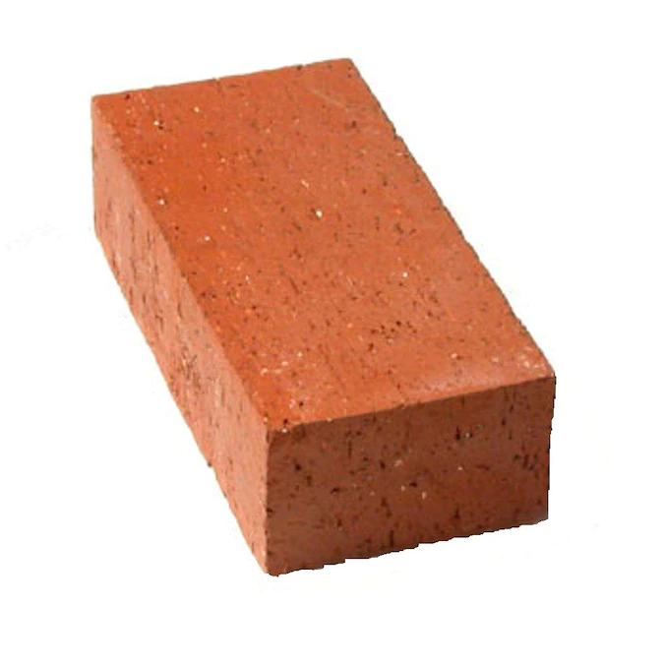
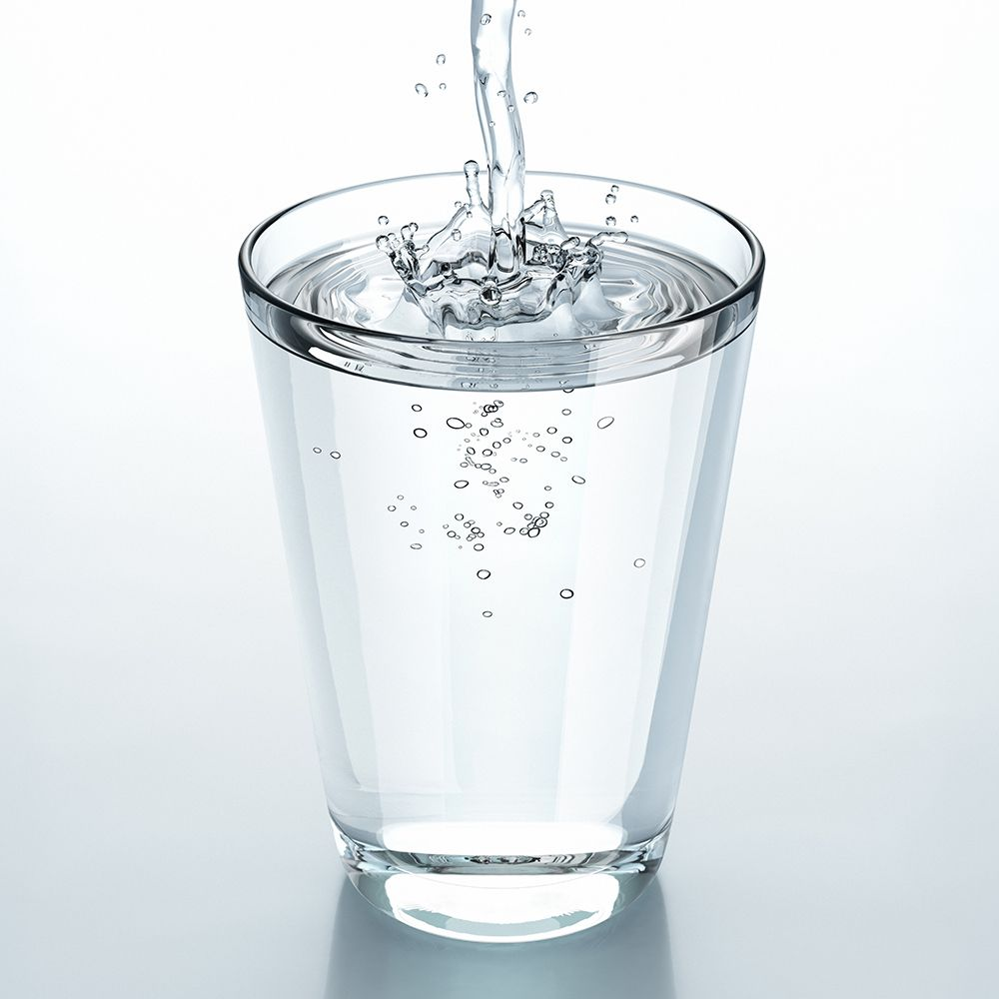

5.1 States of matter
Everything you can see and feel is called matter.

Slide 4
Scientists sort matter into three groups.
These groups are called solid, liquid and gas.
These three groups are called states of matter.

Slide 5
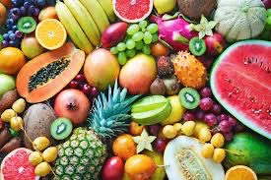

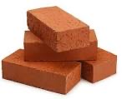
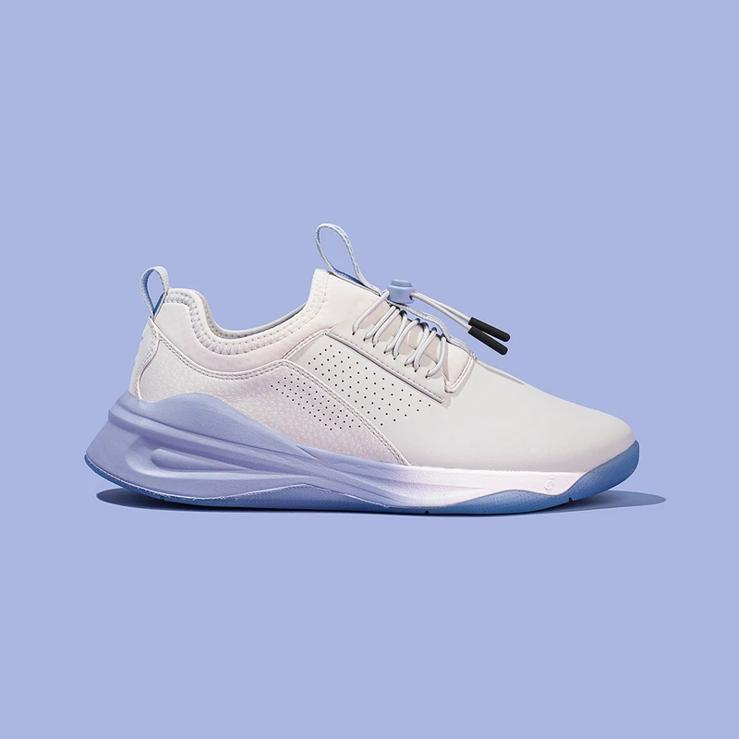
Solids

Slide 6
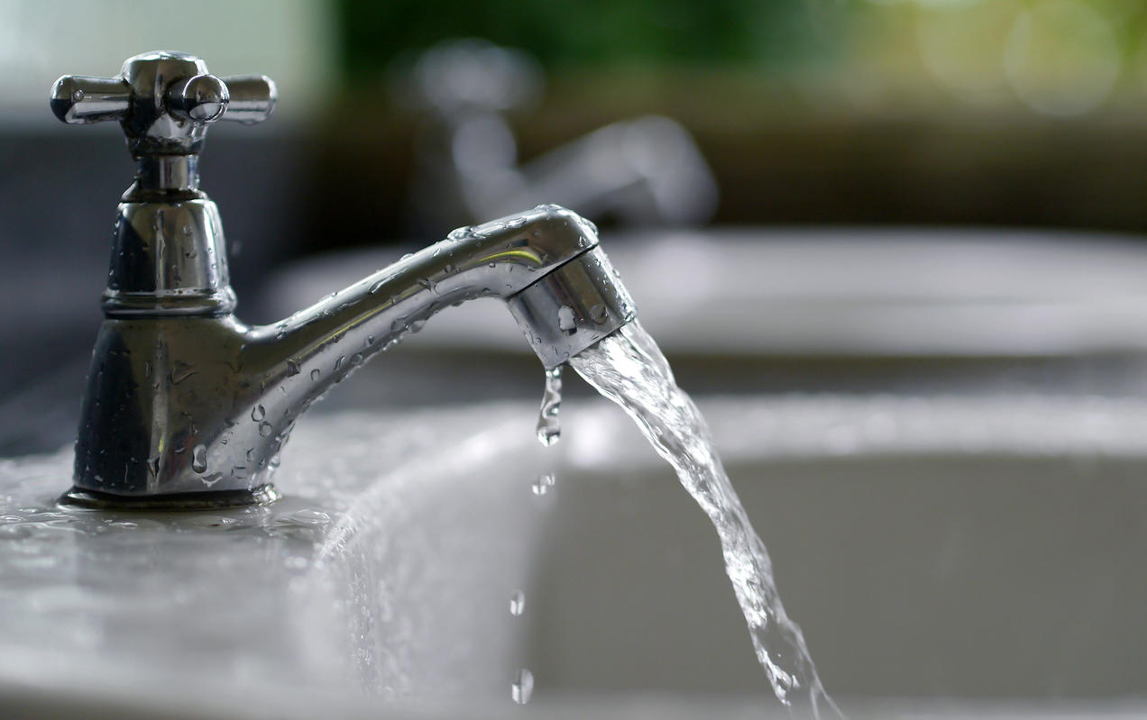
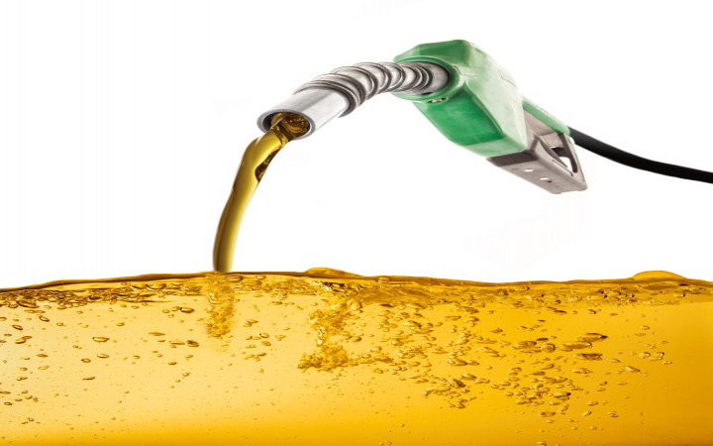
Liquids

Slide 7


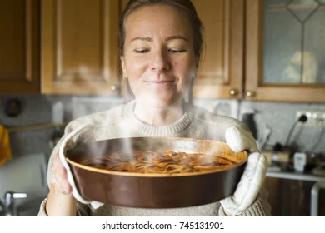
Gas

Slide 8
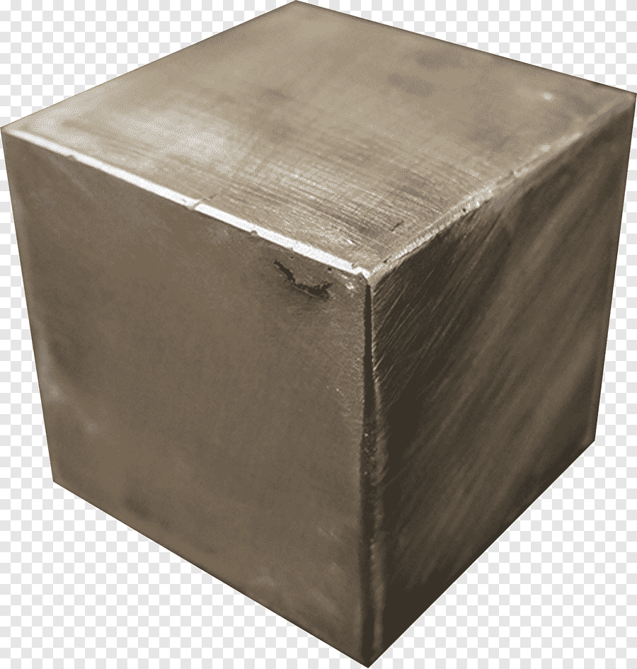
Solid
1000 cm³
Cube
1000 cm³
Cube
Definite volume
Definite shape

Slide 9
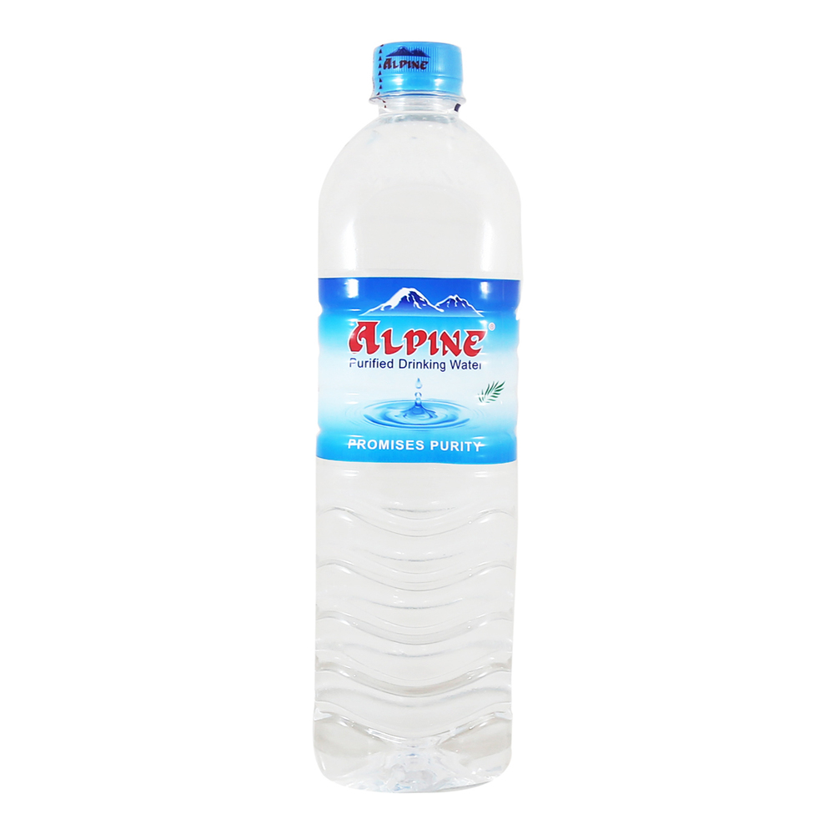
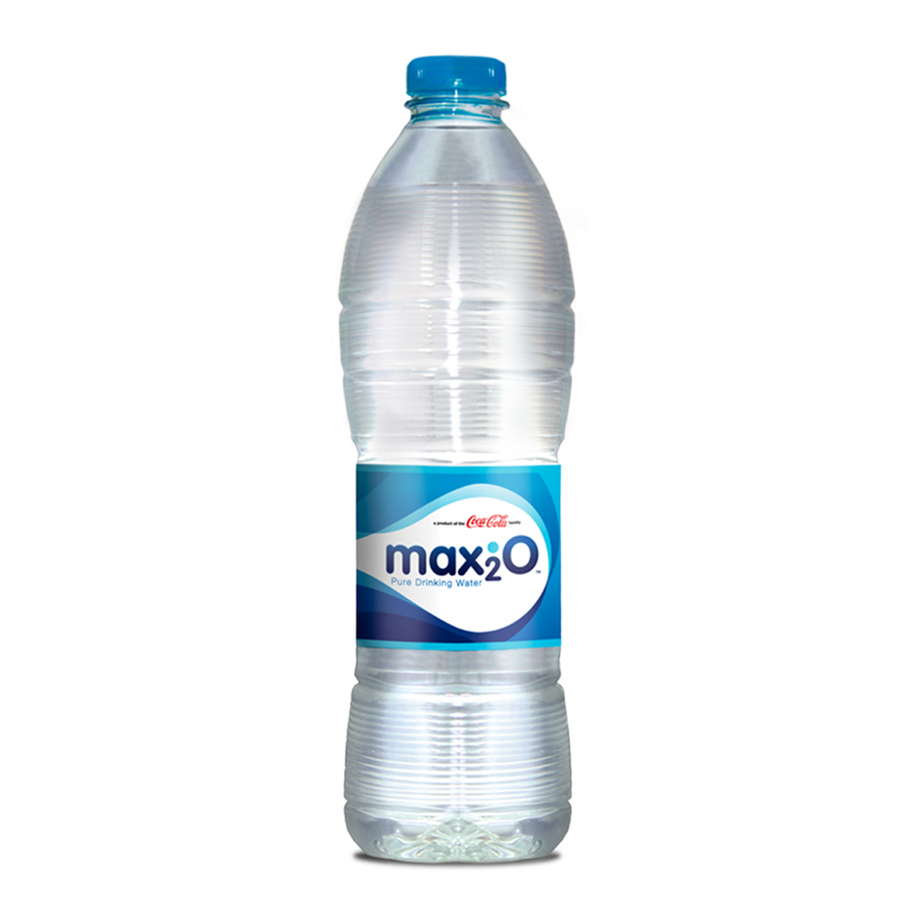
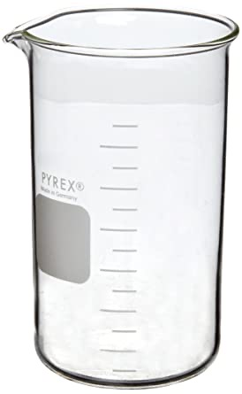
Liquid
1L(or)1000 cm³
Alphine shape
1L(or)1000 cm³
Max₂O shape
1L(or)1000 cm³
Beaker shape
Definite volume
No definite shape

Slide 10
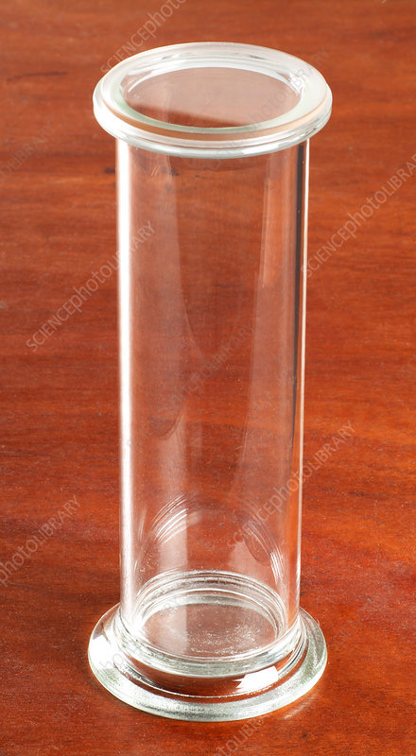
Gas
2L
Longer gas jar
1L
Shorter gas jar
No definite volume
No definite shape

Slide 11
Solid | Liquid | Gas
Definite volume | Definite volume | No definite volume
Definite shape | No definite shape | No definite shape

Slide 12
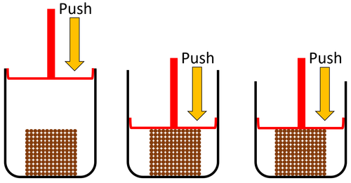
Solid
Cannot be compressed
Does not flow

Slide 13
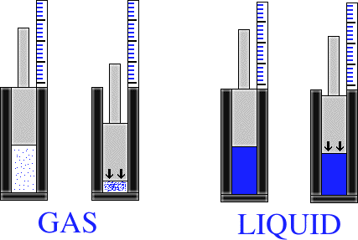
Liquid
Cannot be compressed
Flow

Slide 14
Gas
Can be compressed
Flow

Slide 15
Solid | Liquid | Gas
Cannot be squashed/ (compressed) | Cannot besquashed/ (compressed) | Can be squashed/ (compressed)
Does not flow/(pour) | Flow/(pour) | Flow/(pour)

Slide 16
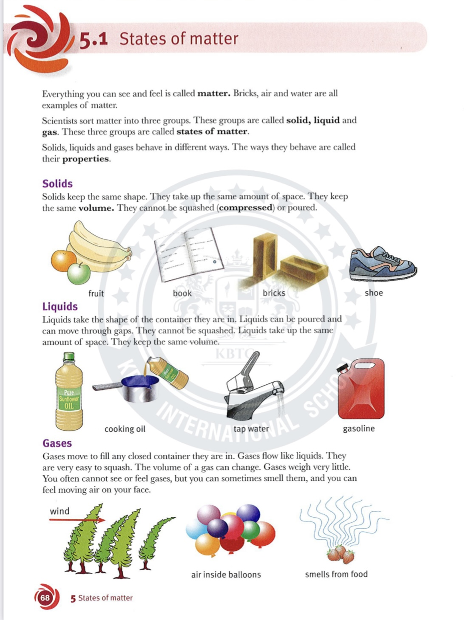

Slide 20
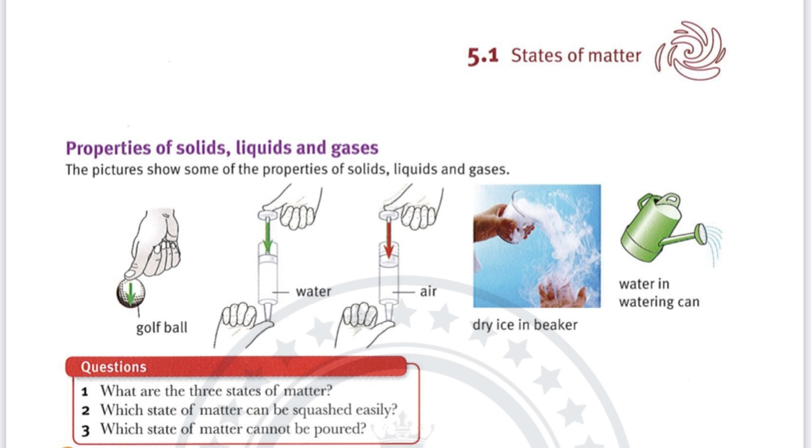

Slide 21
1.Complete the sentences.
(a)Solids,Liquids and gases are called the three ………………………….of matter.
In solids the ……………………………..and ………………………………………stay the same.
Solids cannot be ……………………………and they do not flow.
(b))Liquids always take the shape of the ………………………………they are in.
They cannot be compressed –their …………………..stays the same.
Liquids can be ……………………………
(c)Gases do not have a fixed……………………………………………………… or ……………………………………………………… They can be ………………………………

Slide 22
2. Devon has been asked to test five materials to see if they are solid,Liquid or gas.He has carried out some simple tests on same of the materials. He has not yet completed his tests.
This is his results table.
Material | Can it be compressed? | Does if flow? | Does it stay the same shape? | Does the volume stay the same?
A | Yes | Yes
B |  | Yes |  | Yes
C |  | Yes
D |  | Yes |  | Yes
E |  |  |  | Yes

Slide 23
a. Is material A a solid , a liquid or a gas? Explain your answer.
…………………………………………………………………………………………………………………….
…………………………………………………………………………………………………………………….
……………………………………………………………………………………………………………………. b. Is material B a solid, a liquid or a gas? Explain your answer.
…………………………………………………………………………………………………………………….
…………………………………………………………………………………………………………………….
……………………………………………………………………………………………………………………. c. Devon thinks that material C is either a liquid or a gas.
Which one other test would you carry out to find out which it is? Explain your choice.
…………………………………………………………………………………………………………………….
…………………………………………………………………………………………………………………….
……………………………………………………………………………………………………………………. d. Devon thinks material D is a liquid .Is he correct? Explain the reason for your answer.
…………………………………………………………………………………………………………………….
…………………………………………………………………………………………………………………….
…………………………………………………………………………………………………………………….

Slide 24
e. Devon knows that material E is not a gas.Explain how he knows this.
…………………………………………………………………………………………………………………….
…………………………………………………………………………………………………………………….
……………………………………………………………………………………………………………………. f. What test should he do to decide if material E is a liquid or a solid?
Explain your answer.
…………………………………………………………………………………………………………………….
…………………………………………………………………………………………………………………….
…………………………………………………………………………………………………………………….

